Slide 1
Meaningful Metrics for Demonstrating Ethical Supervision of Unmanned Systems
Workshop on Ethical Computing, AAAI Spring Symposium 2022
Metrics for Measuring AI's Proficiency and Competency for Ethical Reasoning
Don Brutzman and Curtis Blais
Naval Postgraduate School (NPS), Raytheon Corporation
23 March 2022
Notes:
Distribution is unrestricted. See Open-Source License for Ethical Control for details controlling this work. All ideas expressed remain the opinions of originators and do not represent the U.S. Department of Defense.

Slide 2
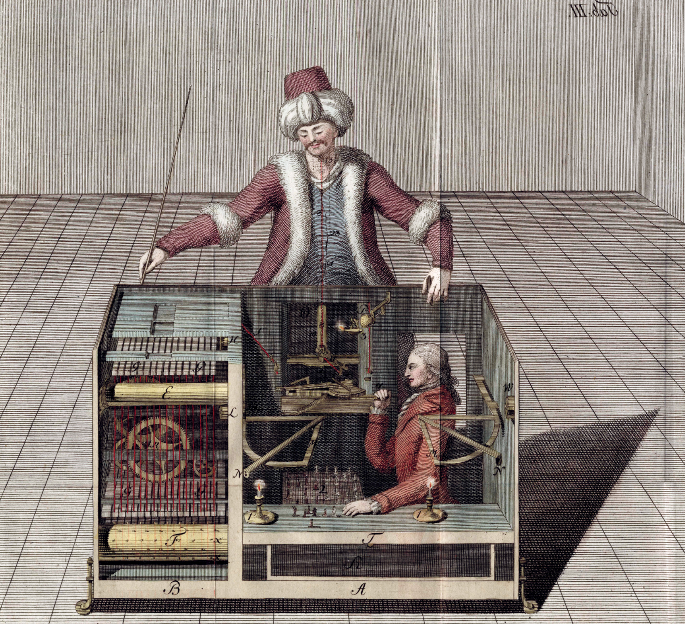

Most egregious claims …
X
____ICE BREAKER !!____
Many people (including big-name AI luminaries) seem to think that some kinda
AI Ethical Agent (perhaps a modern-day Homunculus)
Can sit as a monitoring process on top of any kind of robot software, ensuring that someone else’s robot operates morally legally and ethically.
Such misconceptions have inhibited meaningful progress.
(Example: obligatory Terminator image with glowing red eyes.)
AAAI workshop on metrics is a great step in a necessary direction.

Slide 3
Abstract
Metrics for AI are important, as illustrated by the workshop topics of interest. We note that commonplace gaps in applied AI derive from “Here are the measurements we know how to take” which are too easily over-extrapolated into conclusions of interest. In other words, such precise metrics are necessary and appealing but may not broadly apply to general situations. We assert that necessary subsequent questions are “How do we define meaningful objectives and outcomes for a current unmanned system,” “How do we measure those characteristics that indicate expected success/failure,” and “Once we can measure meaningful results, how do we assemble exemplars into test suites that confirm successful completion across ongoing system life cycles?”
In our work, moral responsibility and authority for ethical behaviors by remote autonomous unmanned systems lies with the humans responsible for robot behavior. Lines of success or failure are clearly defined when delegating tasks to robots which have the capacity for life-saving or lethal force. Goals, constraints and metrics that are shared by humans and robots are formally verifiable as consistent and further testable in repeatable ways. This point paper explores potential design principles of broad value to ethical AI efforts.

Slide 4
First, some centering considerations
Metrics are essential
Precise metrics are necessary
General metrics are elusive
Humans own ethical responsibility and authority
not machines
Can we evaluate whether we are getting better or worse?
system evolution is ongoing

Slide 5
How Do You Measure That?
Critical question that applies to all domains, all perspectives, all aspects
Technical, philosophical, practical, developmental, operational
This means us, i.e. everything in this workshop
If you can’t measure a property or characteristic,
Do you really understand the concept? Perhaps
Have you defined it precisely, unambiguously, uniquely? Probably not
If you can measure something, then can analyze, assess, improve, etc.
Conceptual clarity, representational crispness, repeatable
If not, then people are stuck at talking about what they are talking about

Slide 6
Essential, necessary, elusive
Metrics are essential. Too many AI systems have ill-defined metrics that do not align with the ambitious goals being pursued.
2. Precise metrics are necessary. All claims are suspect if they are not built upon basis that clearly answers common-sense design question “How do you measure that?”
Carpenter’s motto is good heuristic: measure twice, cut once…
3. General metrics are elusive. Metrics must inform the successful evaluations of objectives or else they are confusing and counterproductive.

Slide 7
Who’s in charge? People, software, nothing?
Humans own ethical responsibility and authority.
Legitimacy cannot be fully delegated as ill-defined “autonomy” in AI systems.
There is no omniscient Delphic-oracle homunculus agent.
Human-machine combinations can (and perhaps must) be effective
Are we interested in deciding (making moral judgements) whether specific activities are ethical or not?
Responsibility of human actors carrying out shared laws, governance.
Machines not culpable, legally/ethically/morally, but still can be dangerous.
In-between case: some human-led organizations avoid responsibility by deferring agency to “autonomous” actors, unsafe/unethical deployment

Slide 8

DoD Directive: Autonomy in Weapon Systems
CONTROLLING REFERENCE FOR U.S. DOD
DoD Directive 3000.09, 21 NOV 2012 with change 1, 8 May 2017
Original and update signed by DEPSECDEF Ashton Carter
1. PURPOSE
a. Establishes DoD policy and assigns responsibilities for the development and use of autonomous and semi-autonomous functions in weapon systems, including manned and unmanned platforms.
b. Establishes guidelines designed to minimize the probability and consequences of failures in autonomous and semi-autonomous weapon systems that could lead to unintended engagements.
4. POLICY (excerpted)
a. Autonomous and semi-autonomous weapon systems shall be designed to allow commanders and operators to exercise appropriate levels of human judgment over the use of force.
b. Persons who authorize the use of, direct the use of, or operate autonomous and semi-autonomous weapon systems must do so with appropriate care and in accordance with the law of war, applicable treaties, weapon system safety rules, and applicable rules of engagement (ROE). […]
6. RELEASABILITY. Cleared for public release. […]

Slide 9
People first – machines under human control
___REPEAT___
Only humans have authority, responsibility and accountability for actions with potential for lethal outcomes.
Includes responsibility for unmanned systems under their command
Guiding heuristics for designing new AI-enabled mission capabilities:
How do humans accomplish such goal tasks today?
How might unmanned systems accomplish similar tasks in future?
How can human commanders safely direct and supervise such systems, retaining moral and legal authority over operations?

Slide 10
Building Ethical AI - Moving from Theory to Practice
How do you measure that?

Slide 11
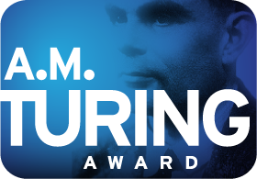
Trusting Software and Trusting Data
Network Optional Warfare (NOW) Blog, January 2016
In 1983, Dennis Ritchie and Ken Thompson jointly received the Turing Award for their development of generic operating systems theory, and specifically for the implementation of the UNIX operating system.
Ken Thompson’s lecture was Reflections on Trusting Trust, with the subtitle “To what extent should one trust a statement that a program is free of Trojan horses? Perhaps it is more important to trust the people who wrote the software.” This talk can still surprise: he describes source code that looks like it does one thing, but actually performs things that are quite different.
So in effect, Ken Thompson chose his Turing Award moment to reveal to the world that he had superuser and user access for every Unix system and server on the planet. Further he revealed that, even with a great many people scrutinizing and rebuilding the source code, and even despite users banging on Unix daily everywhere, anyone else might use a super password for each and every account. Meanwhile no one else knew that the super password existed, much less that it quietly insisted on re-propagating itself in each fresh new copy of Unix. No kidding.
How does the Navy get beyond software barriers to reach the next level of capability:
trust for shared data?

Slide 12
Coactive Design and Interdependency Analysis
Matthew Johnson and Alonso Vera, “No AI is an Island: The Case for Teaming Intelligence”, AI Magazine, vol. 40 no.1, Spring 2019
Abstract. “The purpose of this article is to draw attention to an aspect of intelligence that has not yet received significant attention from the AI community, but that plays a crucial role in a technology’s effectiveness in the world, namely teaming intelligence. We propose that Al will reach its full potential only if, as part of its intelligence, it also has enough teaming intelligence to work well with people. Although seemingly counterintuitive, the more intelligent the technological system, the greater the need for collaborative skills. This paper will argue why teaming intelligence is important to AI, provide a general structure for AI researchers to use in developing intelligent systems that team well, assess the current state of the art and, in doing so, suggest a path forward for future AI systems. This is not a call to develop a new capability, but rather, an approach to what AI capabilities should be built, and how, so as to imbue intelligent systems with teaming competence.”
Strong resonances exist with Ethical Control that deserve further exploration.

Slide 13
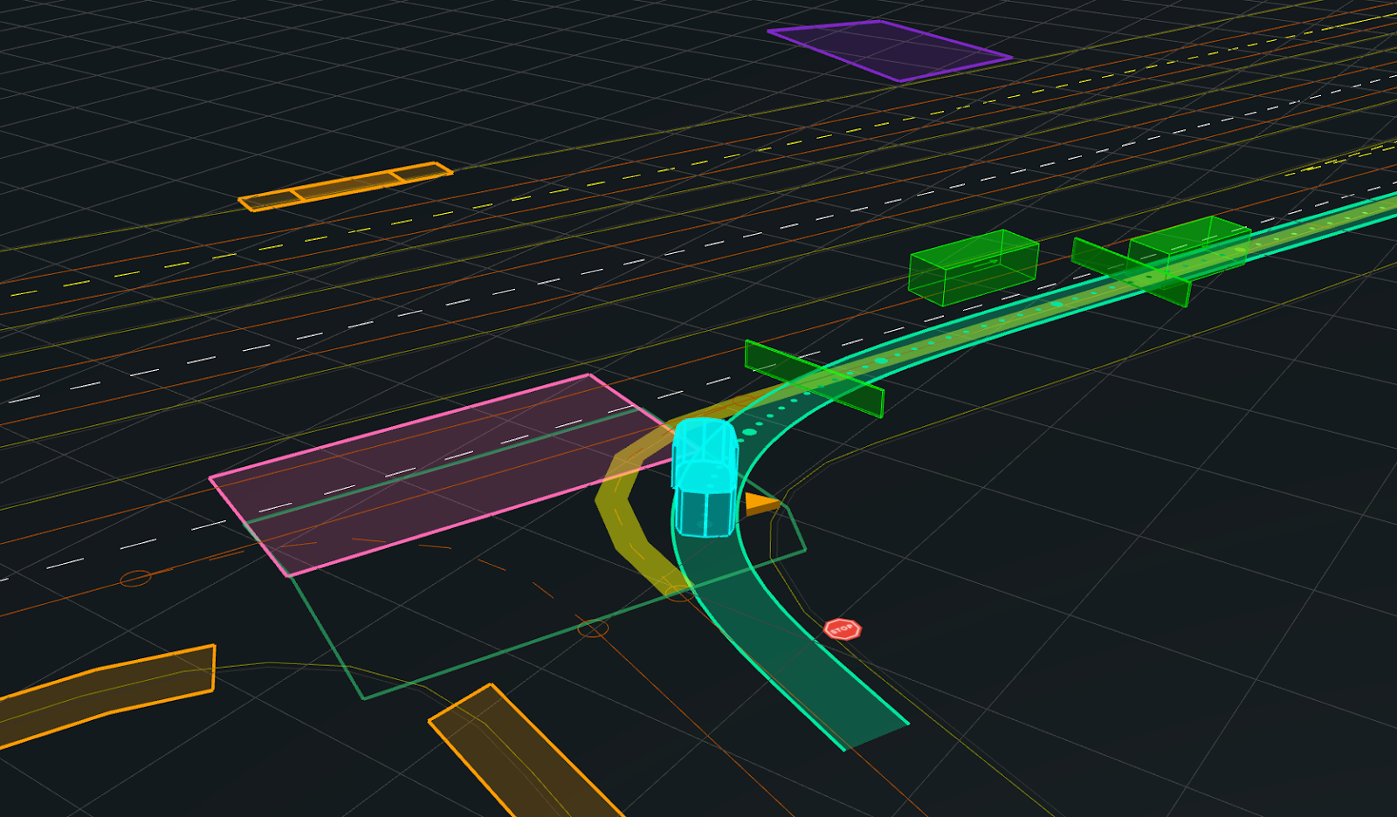
Best practice: “Off road, but not offline: How simulation helps advance our Waymo Driver”
Industry is already operating at scale
Google Waymo blog, 28 April 2020
In simulation, "we drive around 20 million miles a day" and "over 15 billion miles“ total.
LIDAR laser sensors looking in all directions
Physically based modeling, simulation, reenactment
Repeatable real/virtual replay of data and logic
Large-scale regression tests
Why not Navy and USMC?
Notes:
https://blog.waymo.com/2020/04/off-road-but-not-offline--simulation27.html

Slide 14
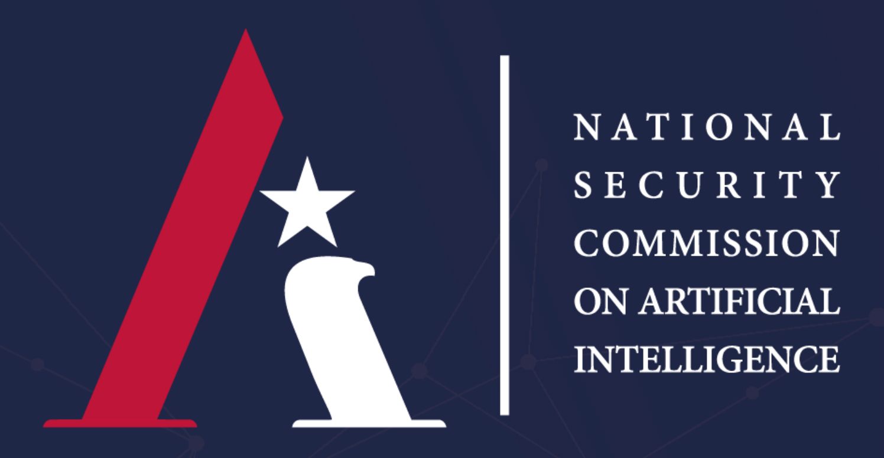
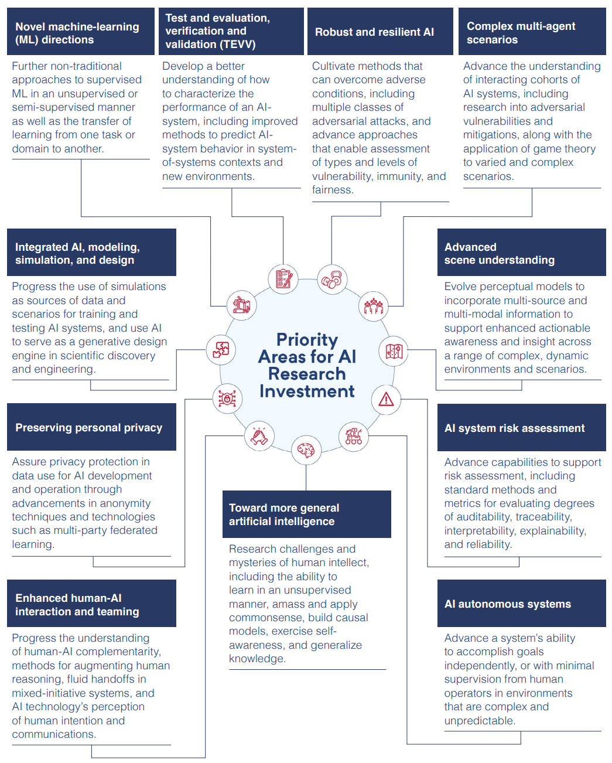
National Security Commission on Artificial Intelligence (NSCAI)
The Final Report presents the NSCAI’s strategy for winning the artificial intelligence era. The 16 chapters explain the steps the United States must take to responsibly use AI for national security and defense, defend against AI threats, and promote AI innovation. The accompanying Blueprints for Action provide detailed plans for the U.S. Government to implement the recommendations.
https://www.nscai.gov
NSCAI completed work 1 OCT 2021

Slide 15
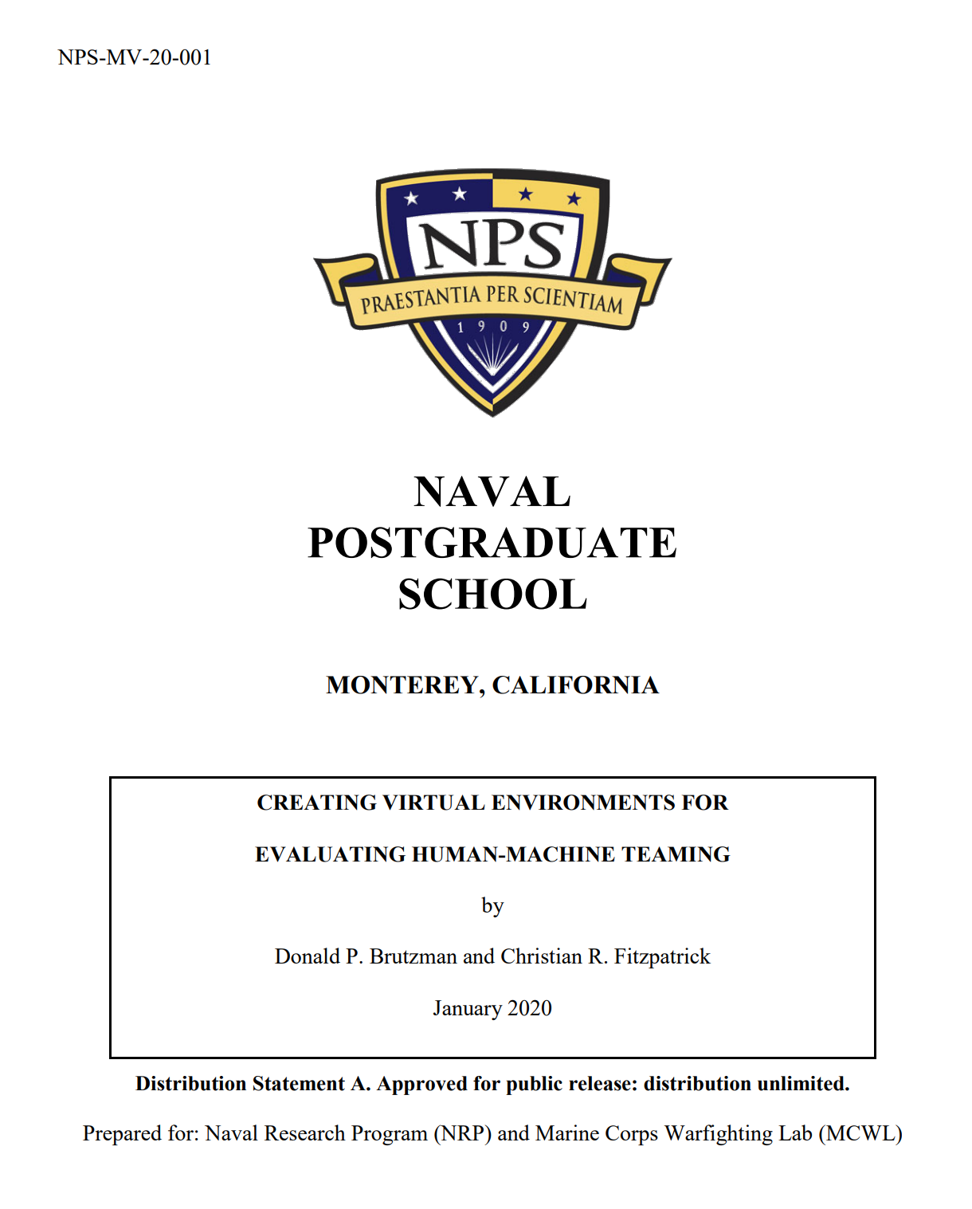
Creating virtual environments for evaluating human-machine teaming
Donald P. Brutzman and Christian R. Fitzpatrick
Technical Report, January 2020, Naval Postgraduate School
Abstract. With the emergence of robots on the battlefield, it is critical for the Marine Corps to tactically integrate existing unmanned assets with manned systems during Marine Air Ground Task Force (MAGTF) operations. In parallel, the Marine Corps must also look forward to identify capability gaps that future unmanned systems might address. To do both requires extensive field testing, which is often unfeasible and always costly. This effort proposes the use of virtual environments (VE), virtual reality (VR) and agent-based modeling to conduct scenario-based assessments of Manned-Unmanned Teaming (MUM-T) during combat operations. To pursue such goals, the project examined a variety of relevant tactical scenarios where Marines and robots act in concert to achieve specific mission objectives. Such tactical scenarios are further assessed using deterministic combat simulations to create a valid methodology for behavior creation and assessment within each scenario-specific problem space.
https://calhoun.nps.edu/handle/10945/64266

Slide 16
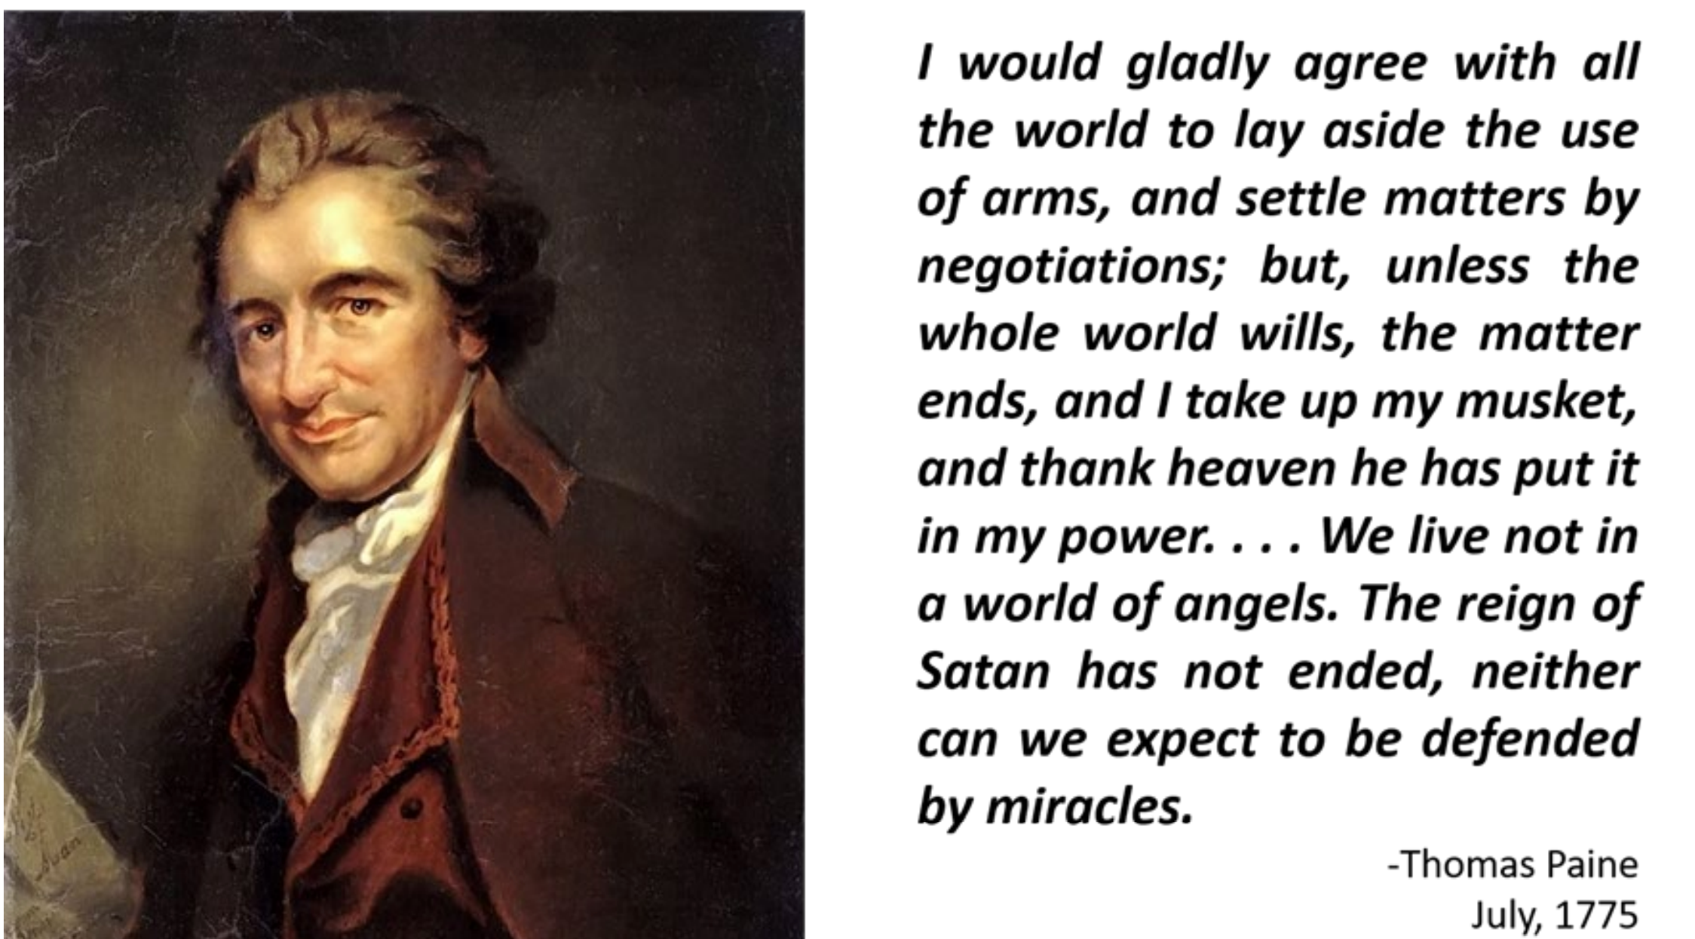
Dimensions of Autonomous Decision-making
Dimensions of Autonomous Decision-making
A First Step in Transforming the Policies and Ethics Principles Regarding Autonomous Systems into Practical System Engineering Requirements
Michael F. Stumborg, Becky Roh, Mark Rosen
CNA, December 2021
This study identifies the dimensions of autonomous decision-making (DADs)—the categories and causes of potential risk that one should consider before transferring decision-making capabilities to an intelligent autonomous system (IAS).
Over 500 risk elements associated with real-world robotics usage distilled, correlated and grouped in semantic categories.
https://www.cna.org/news/releases/2022-01-24
https://www.cna.org/CNA_files/PDF/Dimensions-of-Autonomous-Decision-making.pdf

Slide 17
Qualification of unmanned systems: extend Verification Validation Accreditation (V V&A)
Proposed Future Work
SISO V V&A Study Group
How to test and certify robots will follow both orders and constraints? Humans confirm understanding and trust through qualification processes.
Design, construct “qualification card” for testing unmanned systems…
Comprehensive virtual environment, hardware/software in the loop.
Carefully crafted scenario testing of key requirements and capabilities.
Anti-pattern tests to provoke and confirm constraints are not violated.
Record all unit-test decision trees, decision-branching traces, and results as a certification record for each hardware/software version of robots.
Visualize realistic rehearsal, real-time and replay of robot operations repeatably using shared Web-based SPIDERS3D virtual environment.
Humans assess mission logs and scenario outcomes for after-action analysis, lessons learned, and continuous improvement via suite of unit tests.

Slide 18
Must… have…. data….. more…… data……. mor
Data Strategy for Unmanned Systems
Field Experimentation (FX), Simulation and Analysis
Abstract. Data collection and analysis techniques for robot experiments are haphazard and incomplete. Building best-practice workflows for data and metadata from unmanned systems can leverage both field experimentation (FX) and simulation to support archival data re-use and repeatable analysis. Reusable end-to-end data workflows are needed.
https://wiki.nps.edu/display/NOW/Data+Strategy+for+Unmanned+Systems

Slide 19
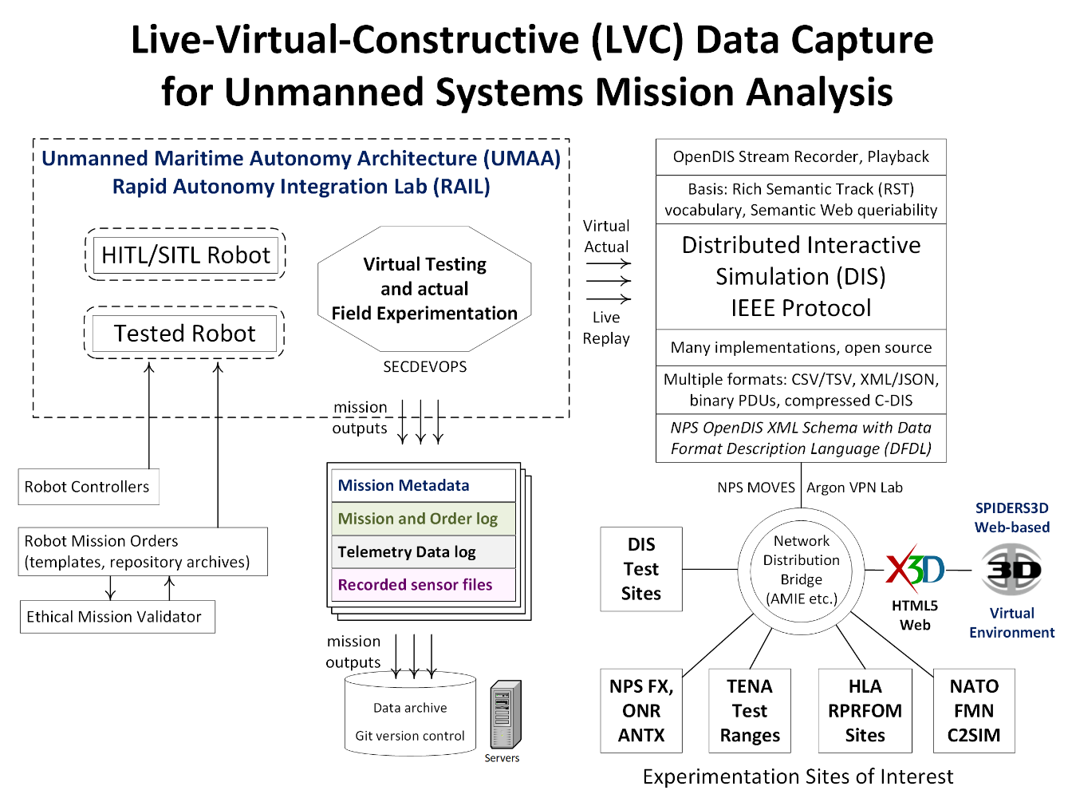

Slide 20
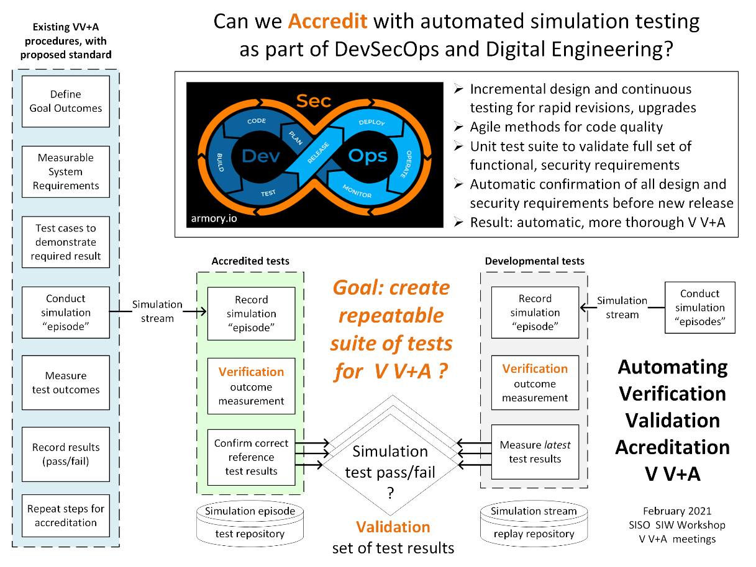

Slide 21
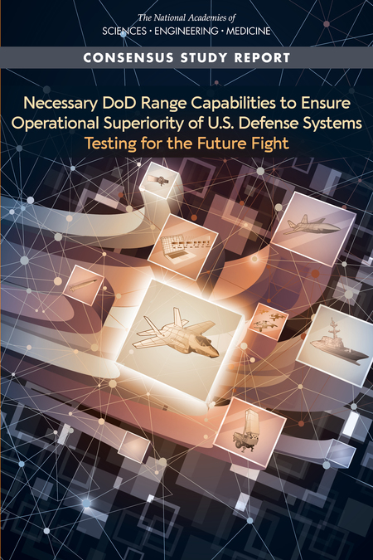
Imperatives and possibilities in military context
Assessing Physical and Technical Suitability of DoD Test and Evaluation Ranges, Infrastructure
Rigorous operational testing (OT) of weapon systems procured by the U.S. Department of Defense (DoD) is fundamental to ensuring that these sophisticated systems not only meet their stated requirements, but also perform under realistic operational conditions when faced by determined adversaries employing their own highly capable offensive and defensive weaponry. DoD's test and training range enterprise provides the geography, infrastructure, technology, expertise, processes, and management that make safe, secure, and comprehensive OT possible.
The challenges facing the nation's range infrastructure are both increasing and accelerating. Limited test capacity in physical resources and workforce, the age of test infrastructure, the capability to test advanced technologies, and encroachment impact the ability to inform system performance, integrated system performance and the overall pace of testing.
National Academies of Sciences, Engineering, and Medicine. 2021. Necessary DoD Range Capabilities to Ensure Operational Superiority of U.S. Defense Systems: Testing for the Future Fight. Washington, DC: The National Academies Press. https://doi.org/10.17226/26181 (includes presentation)

Slide 22
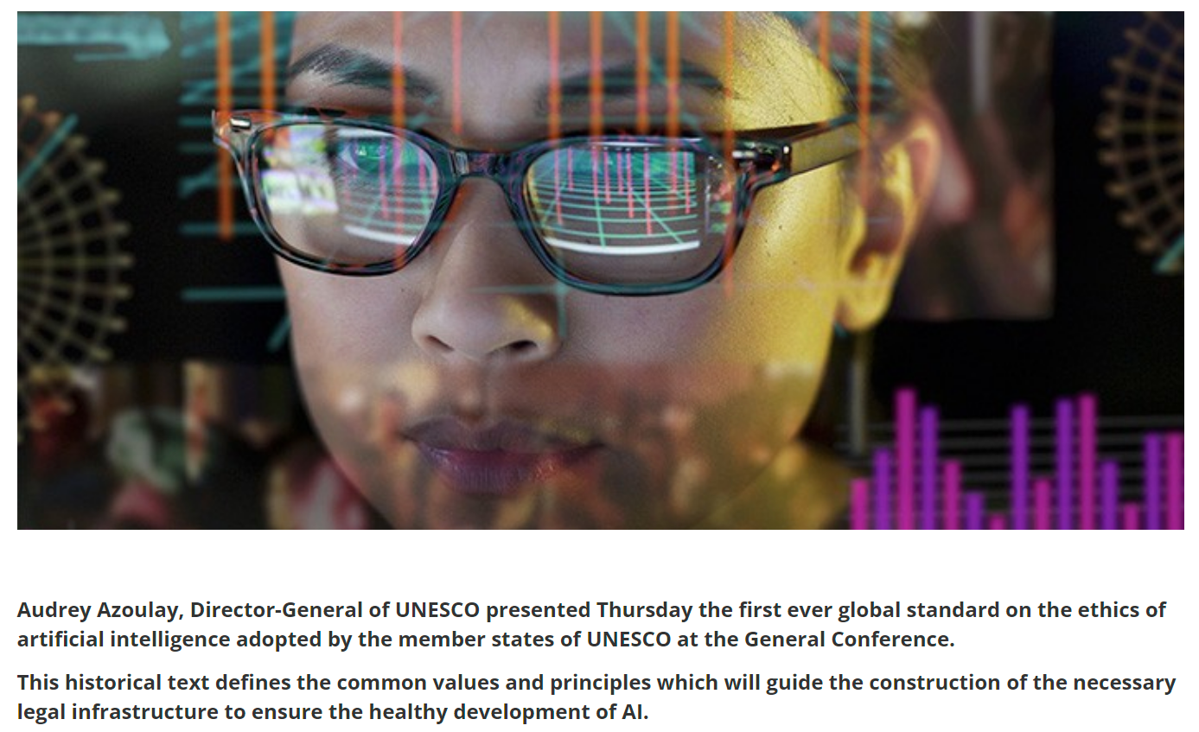
UNESCO member states adopt the first ever global agreement on the Ethics of Artificial Intelligence
AI is pervasive, and enables many of our daily routines - booking flights, steering driverless cars, and personalising our morning news feeds. AI also supports the decision-making of governments and the private sector.
AI technologies are delivering remarkable results in highly specialized fields such as cancer screening and building inclusive environments for people with disabilities. They also help combat global problems like climate change and world hunger, and help reduce poverty by optimizing economic aid.
But the technology is also bringing new unprecedented challenges. We see increased gender and ethnic bias, significant threats to privacy, dignity and agency, dangers of mass surveillance, and increased use of unreliable AI technologies in law enforcement, to name a few. Until now, there were no universal standards to provide an answer to these issues.
Recommendations: Protecting data, Banning social scoring and mass surveillance, Helping to monitor and evaluate, Protecting the environment
https://en.unesco.org/news/unesco-member-states-adopt-first-ever-global-agreement-ethics-artificial-intelligence

Slide 23
Analytic questions of interest – to ethical AI practitioners
Repeatability
What happened? What changed? What’s next? What will happen?
What can we learn from all data + all operations? … Will we prevail?
Understandability
Do I entrust this robot with authority for lethal or lifesaving force?
Do these combined human-machine actions make sense to team?
Trust and Verification, Validation, Accreditation (V V+A)
Is a robot system (hardware, software, sensors) qualified to deploy?
What is Modeling + Simulation basis for analysis-development loop?

Slide 24
Conclusions and Recommendations
Metrics are essential for ethical AI repeatability
Metrics actually drive conceptualization, operationalization, evolution
You Get What You Measure
Testing brings theory into practice
Live-Virtual-Constructive (LVC) approaches are possible
Building testbed frameworks for measurable performance establishes basis for verification validation + accreditation (VV+A), robot certification, even actionable conventions, professional practices, and laws
Is it time for AI ethics to “get real” and “walk the walk” yet?

Slide 25
Contact
Don Brutzman
brutzman@nps.edu
http://faculty.nps.edu/brutzman
Code USW/Br, Naval Postgraduate School
Monterey California 93943-5000 USA
1.831.656.2149 work
1.831.402.4809 cell
Notes:
Questions and feedback are always welcome. Thanks for considering the possibilities.

Slide 26
Contact
Curt Blais
clblais@nps.edu
https://nps.edu/faculty-profiles/-/cv/clblais
Code MV/Bl, Naval Postgraduate School
Monterey California 93943-5000 USA
1.831.656.3215 work
Notes:
Questions and feedback are always welcome. Thanks for considering the possibilities.

